Slide 1

Corpus Presenter
─ Quick and Blitz Searches ─
Raymond Hickey
www.raymondhickey.com

Slide 2
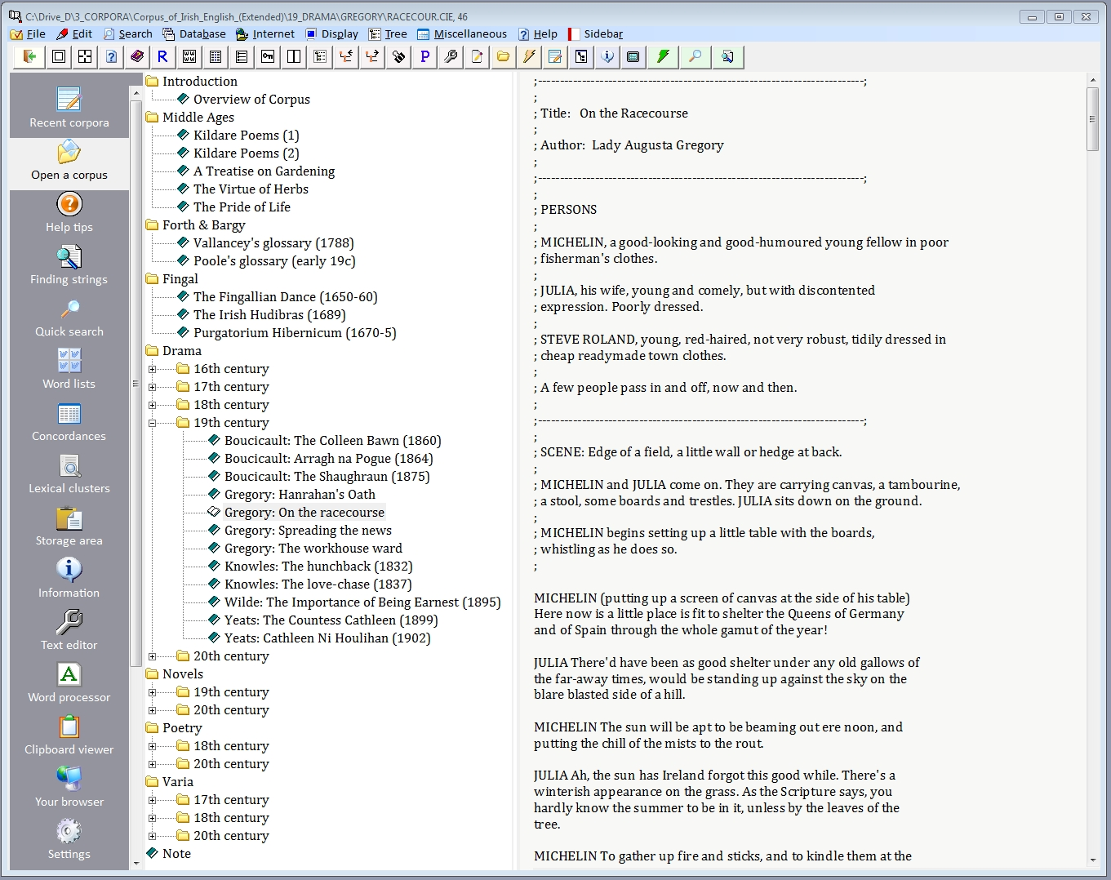
There are two main search options in Corpus Presenter. The second is Quick Search which provides for searches of word forms throughout corpus files.

Slide 3
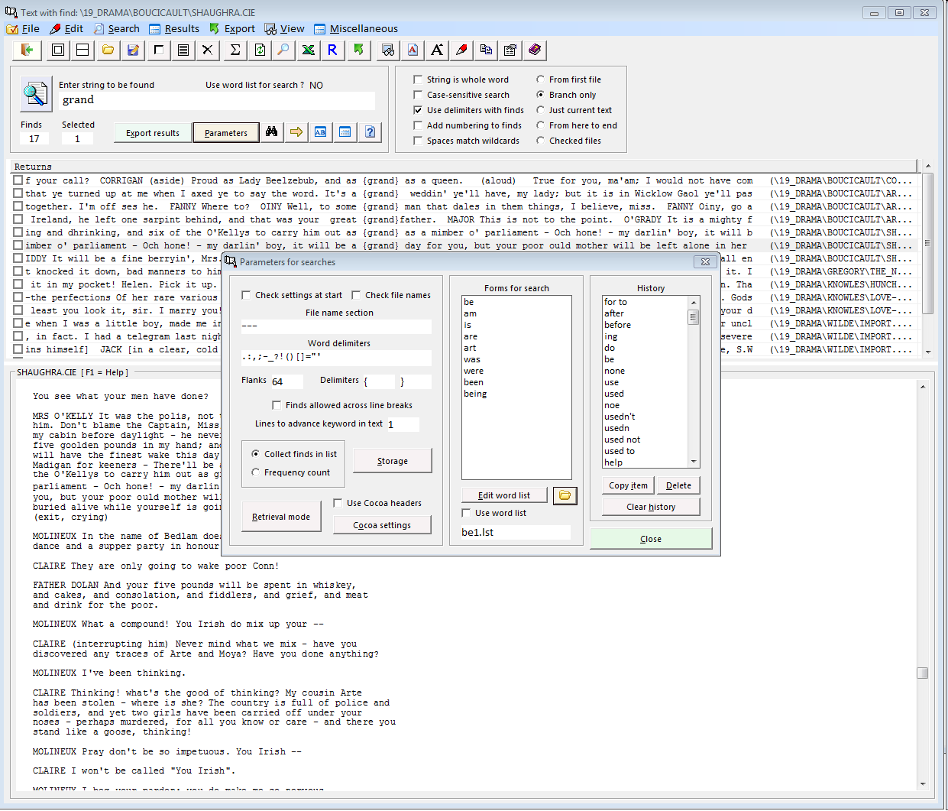
To start a Quick Search all you need to do is enter a word on thext line and choose a range for the search, e.g. the files of a certain branch. If you open the Parameters window you can choose to use a list of word forms for a search.

Slide 4
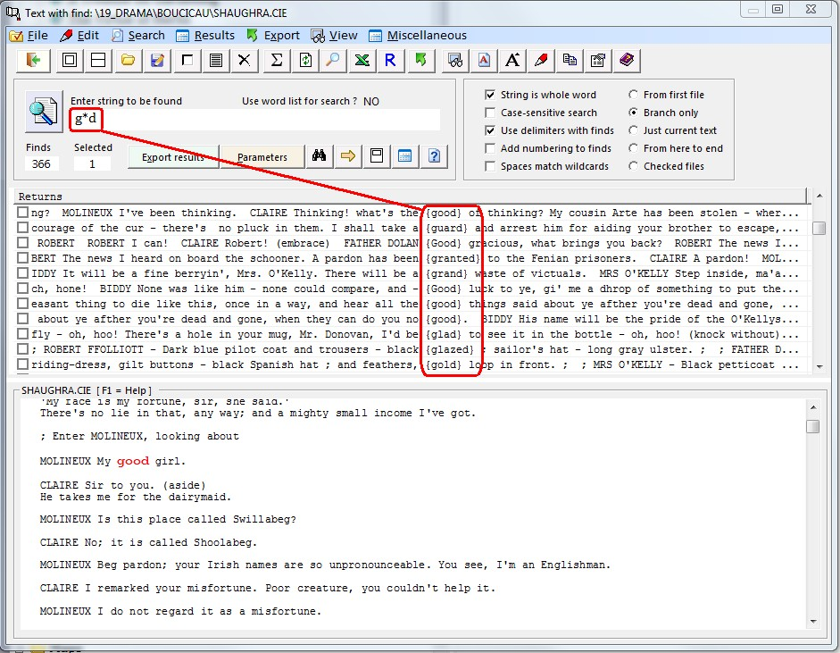
You can also use wild cards (* = several unspecified characters; ? = one unspecified character). By this means you can find several different words which match the wild card template (see screen shot on right)

Slide 5
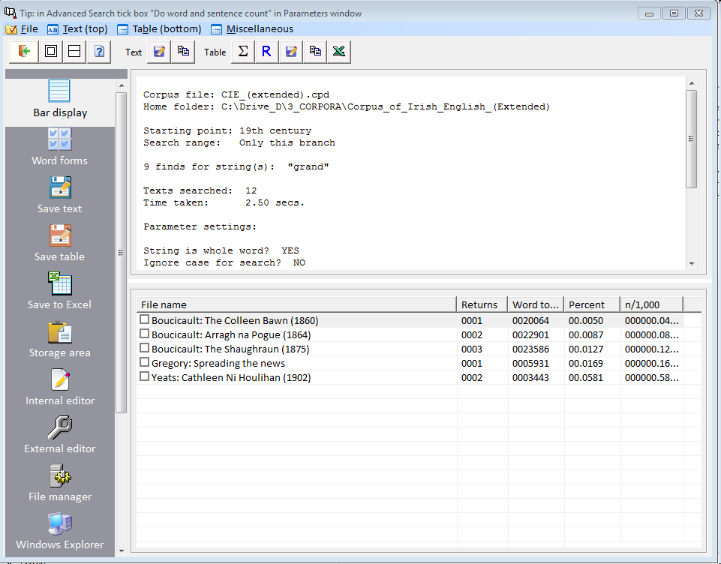
The numerical results of a search are displayed in a separate window the contents of which can be exported, e.g. an Excel spreadsheet for further processing.

Slide 6
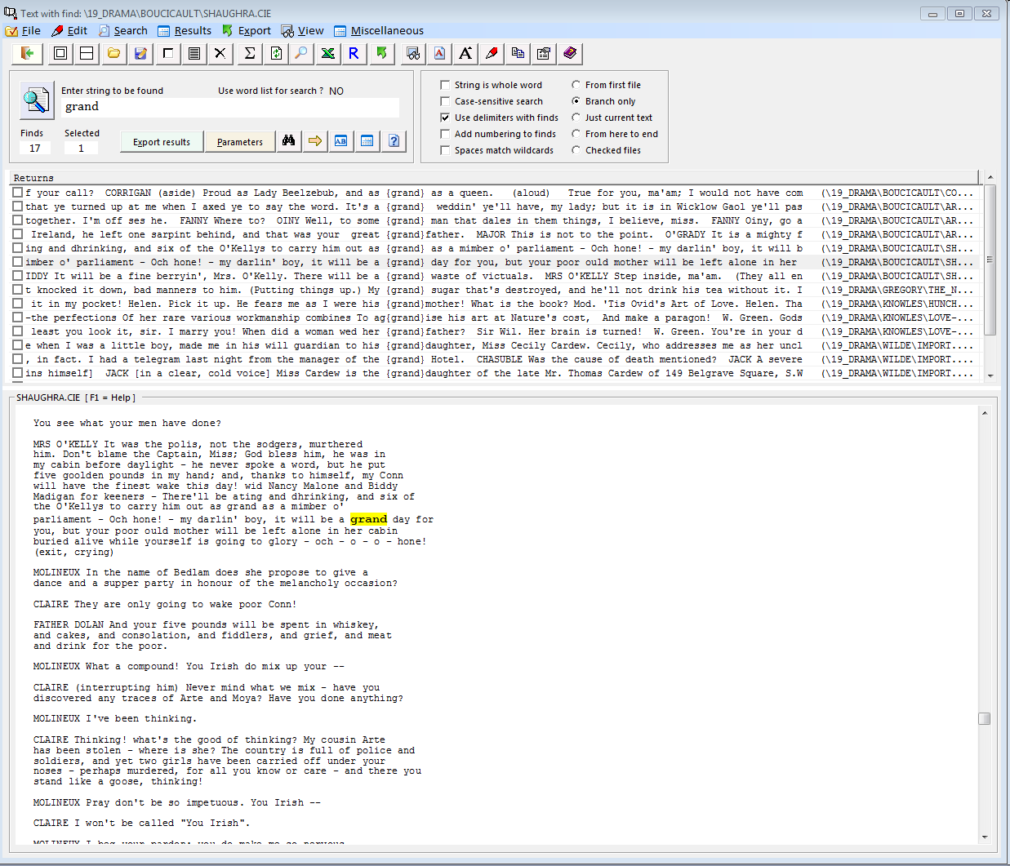
The results of a search are shown as a list with the word looked for in the middle and some context to the left and right. By clicking on any line the programs shows the position of the word in the file in which it was found (highlighted in yellow).

Slide 7
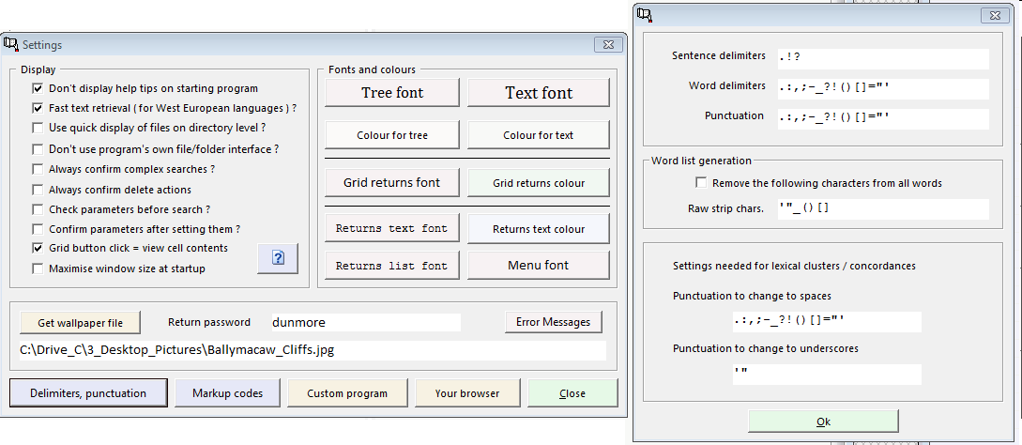
Settings for Corpus Presenter (here: punctuation)
For searches to yield accurate results you need to specify what characters are to be understood as punctuation, e.g. in whole word searches. This is done via the Settings window (shortcut: F3).

Slide 8
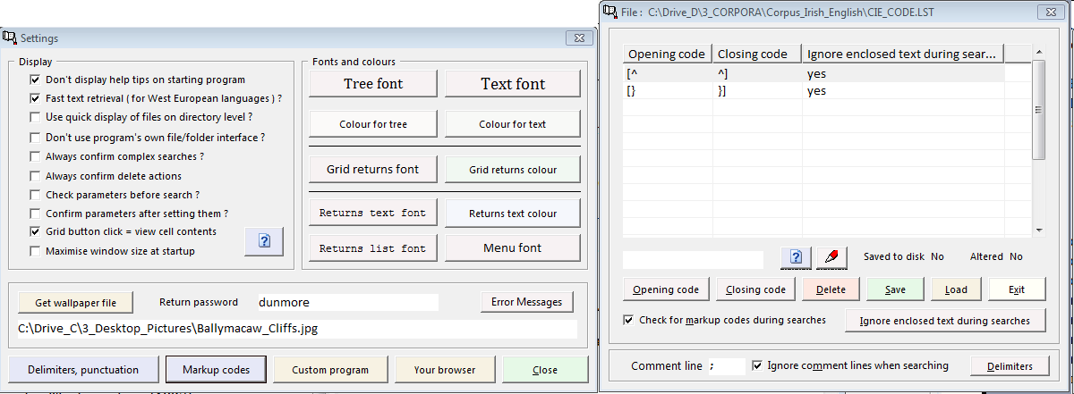
Settings for Corpus Presenter (here: markup codes)
To exclude certain parts of a text from searches, you can specify markup code which then enclosed text which is not to be search through. You can also specify a comment line character which ensure that the lines in question are ignored during a search.

Slide 9
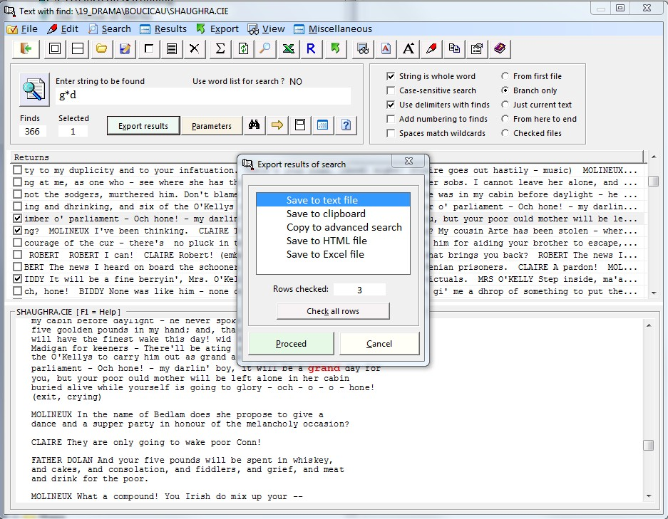
The results of a search can be saved in a number of ways (see screenshot below), depending on how you wish to use the results afterwards.

Slide 10
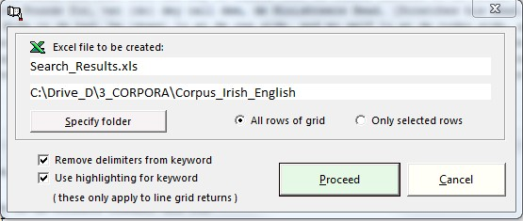
One of the most flexible output options is as an Excel spreadsheet. For this there is a special option in which you specify the name for the output file, the number of rows from the returns grid to be copied to Excel, etc. Results stored in an Excel spreadsheet can be further processed by other software, e.g. graphic software.

Slide 11
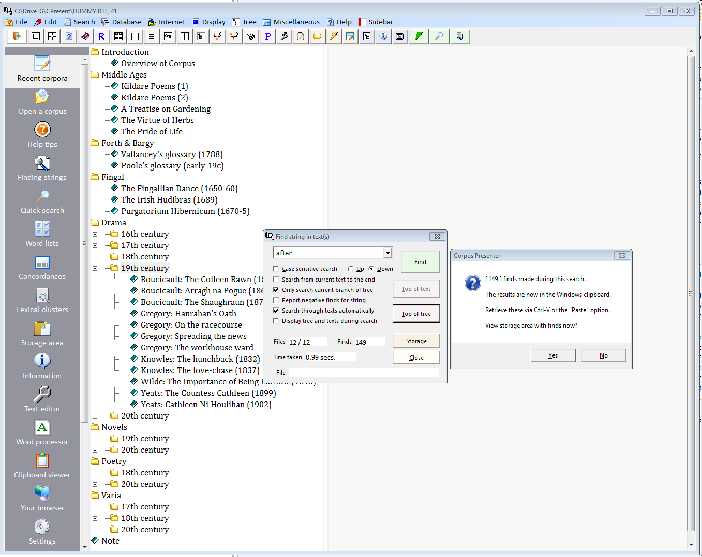
With “Blitz search” you can perform quick and easy searches
The “Blitz search” option allows you to find words quickly in any set of files in a corpus.
The results are deposited in the Windows clipboard and can also be seen in the storage area.

Slide 12
Where to put the results of searches
Corpus Presenter provides a text storage area in which you can posit any text which has been copied to the Windows clipboard, e.g. some results from a search through corpus text files.
The contents of the storage area remains available all through a work session. If you attempt to leave Corpus Presenter with contents in the storage area then you are warned about this an advised to store it on disk or copy it back to the Windows clipboard for further use.
There is also a supplied utility – called CP Clipboard Viewer – which will store the previous 12 sets of Windows clipboard contents.

Slide 13
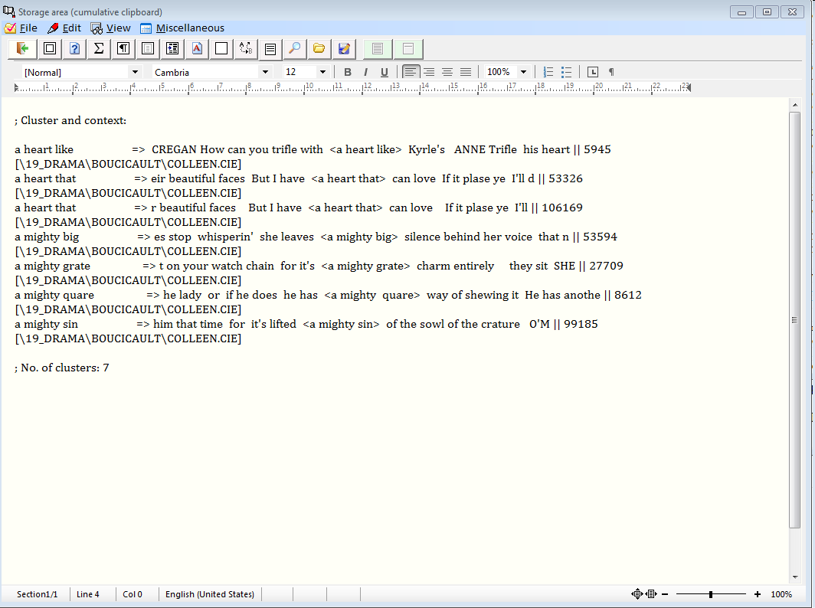
Holding text in the storage area, an internal editor which is active during any work session with Corpus Presenter.

Slide 14
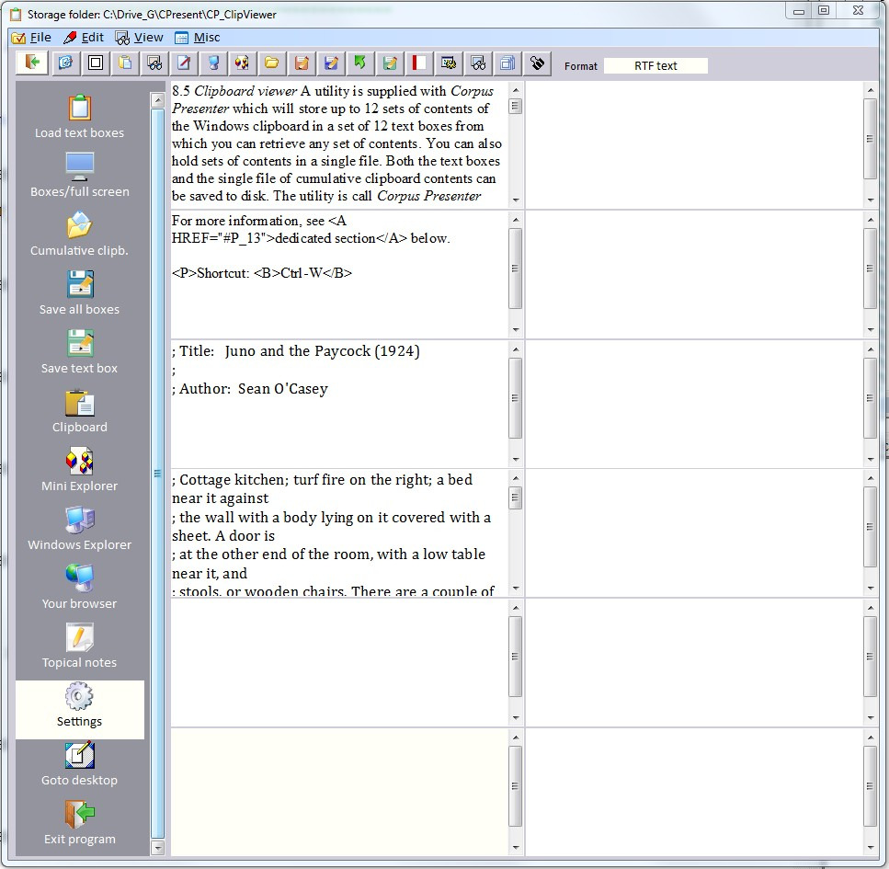
Clipboard Viewer, this holds the last 12 sets of Windows clipboard contents.

