Slide 1

Corpus Presenter
─ Finding Strings ─
Raymond Hickey
www.raymondhickey.com

Slide 2
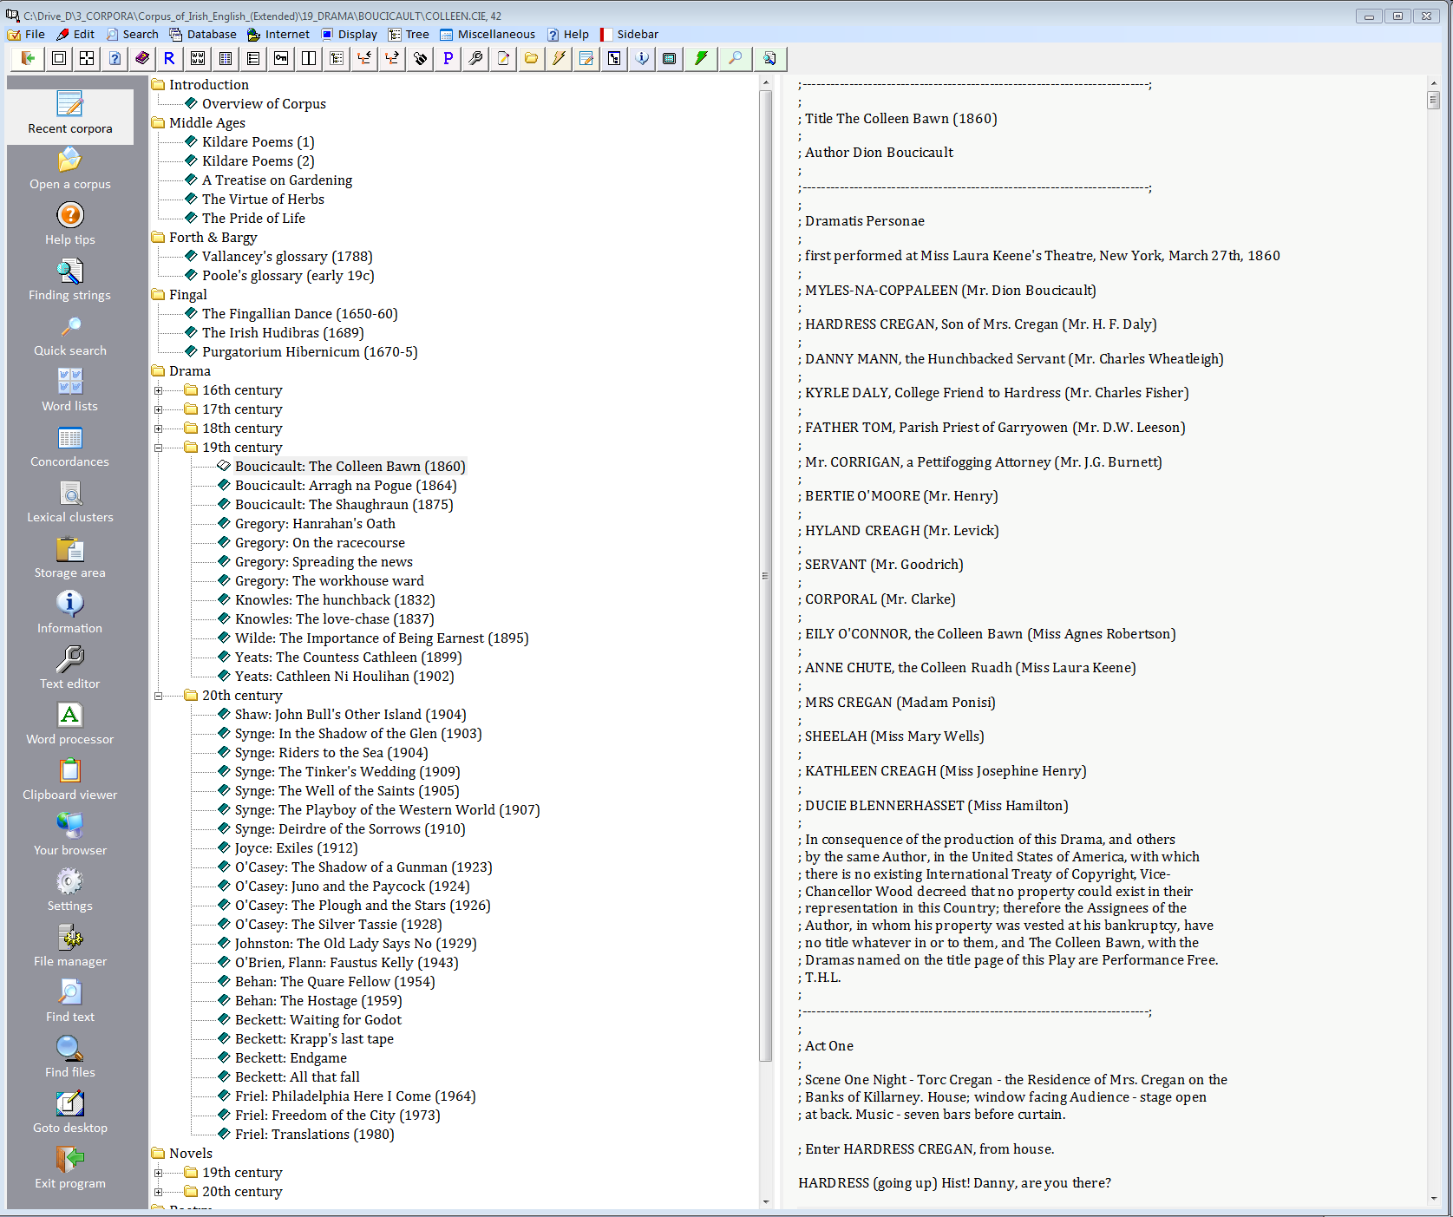
Finding strings in corpus files
The current option allows you search for a variety of strings through any files of your corpus. Two string searches and the use of wildcards are allowed, adding flexibility to your searches.

Slide 3
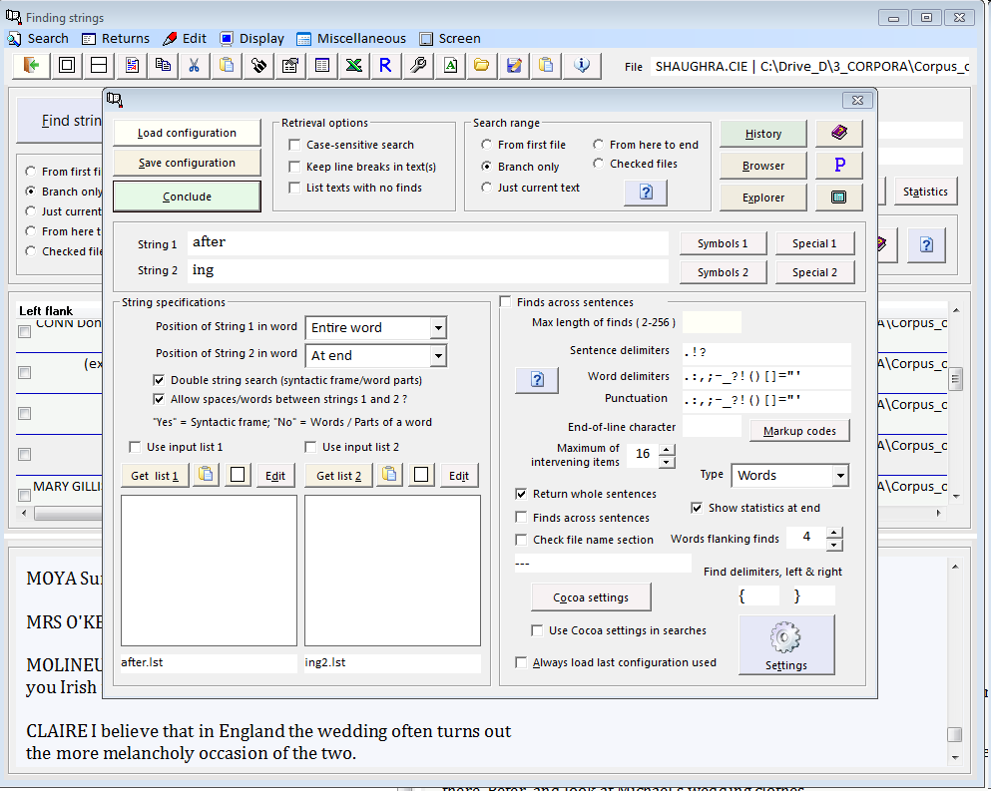
Finding strings in through corpus files
To do complex searches you must first of all specify the information necessary for a search. The main items are the first and second strings. Then you can specify further information, such as the position of a string in a word, the number of intervening items, etc.

Slide 4
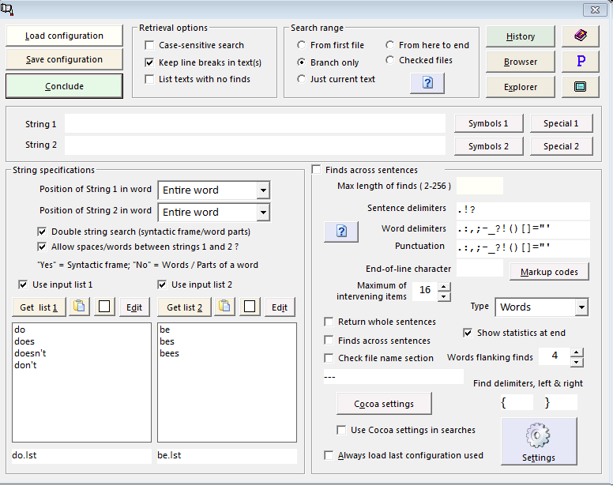
Finding strings in corpus files
Note that you can do more powerful searches on this level by using input lists for both the first and second strings. This allows the program to search for a number of forms during one search run and so improves flexibility.

Slide 5
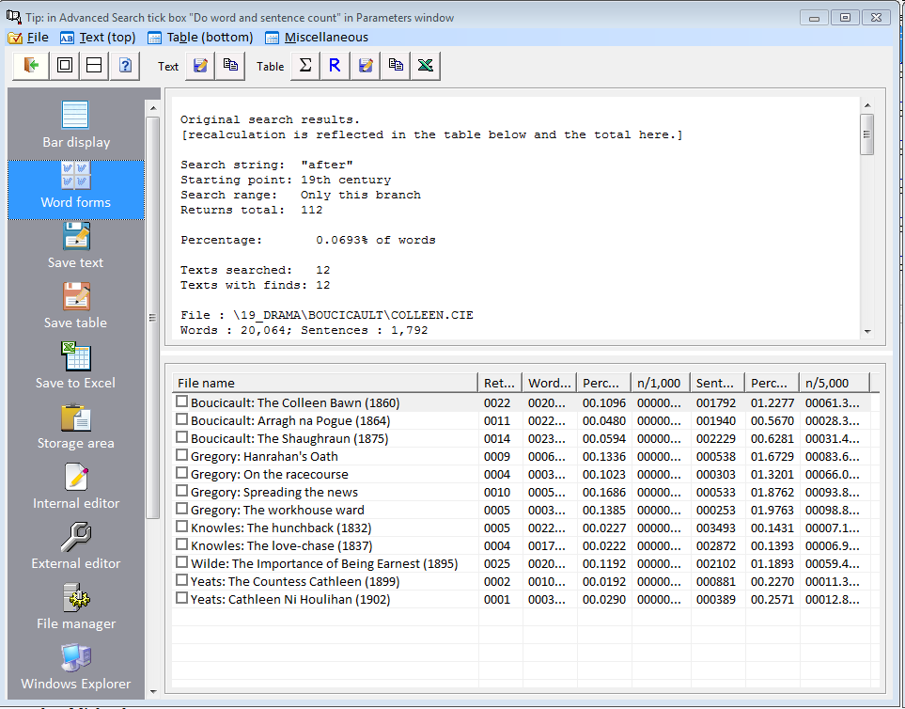
Finding strings in corpus files
Corpus Presenter displays the statistics from an advanced search in the same way as with other searches and you can store this information on disk for later use.

Slide 6
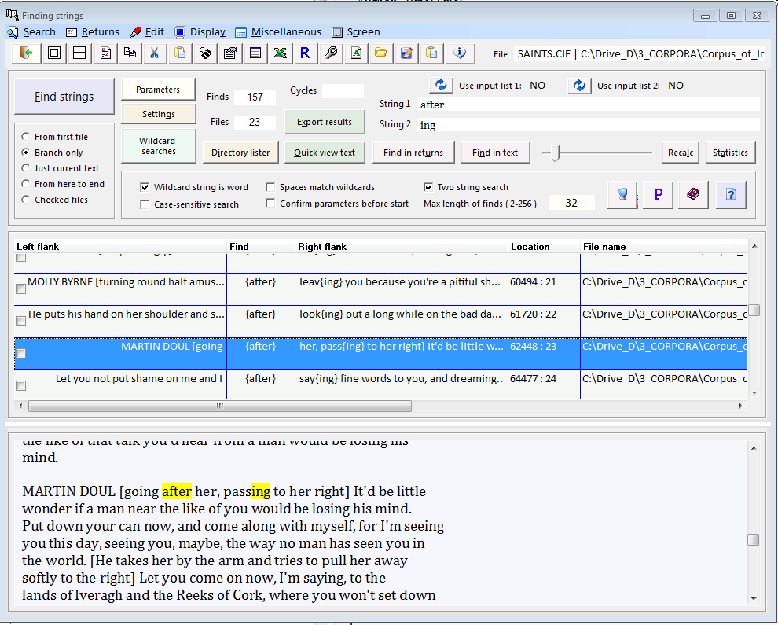
Finding strings in corpus files
Some of the results returned may be spurious and it is up to the user to decide this. You can delete false finds from the grid and then Recalc the statistics to get accurate results.
This is an incorrect return. It needs to be removed with the statistics calculated afresh.

Slide 7
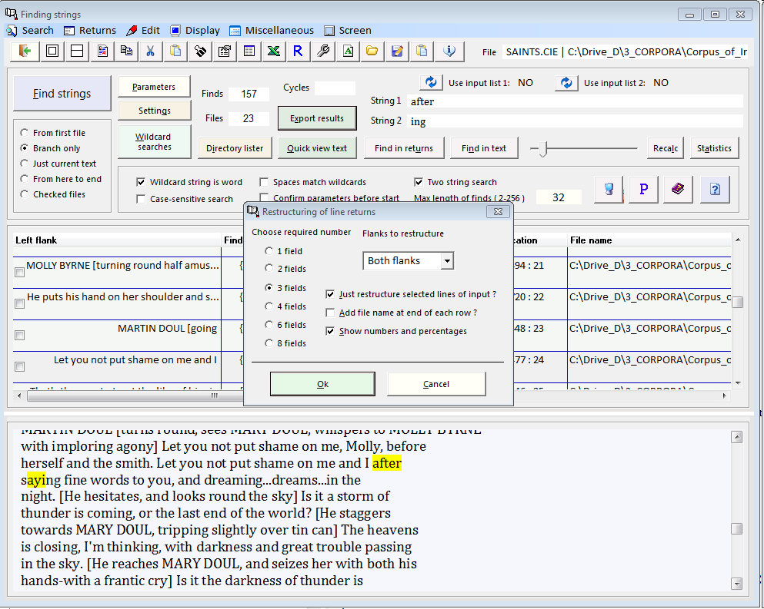
Finding strings in corpus files
You can determine the collocations on the left and right of string finds on the present level (goto Display, then Determine collocations or just press Ctrl-F11.

Slide 8
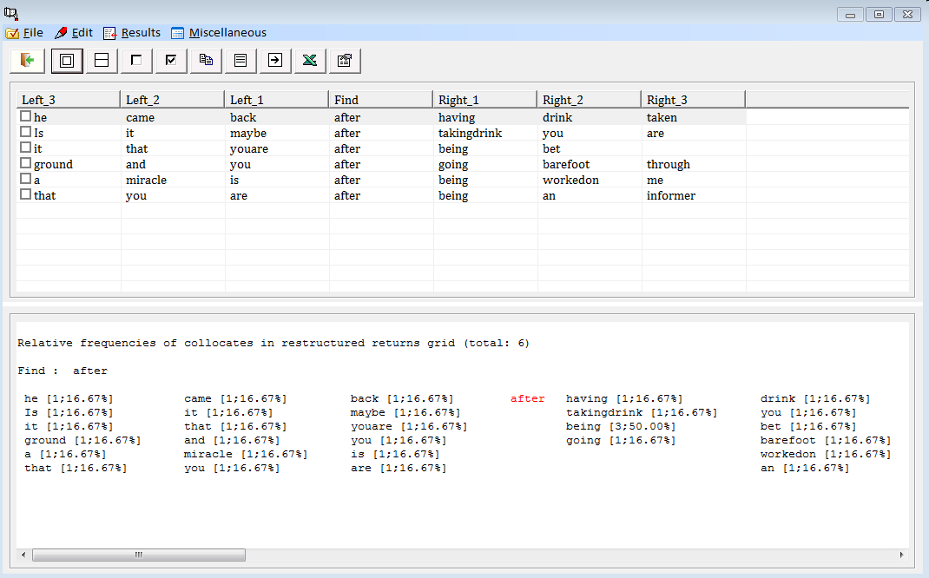
Finding strings in corpus files
Collocations, three words to the left and right of a selection of finds.

Slide 9
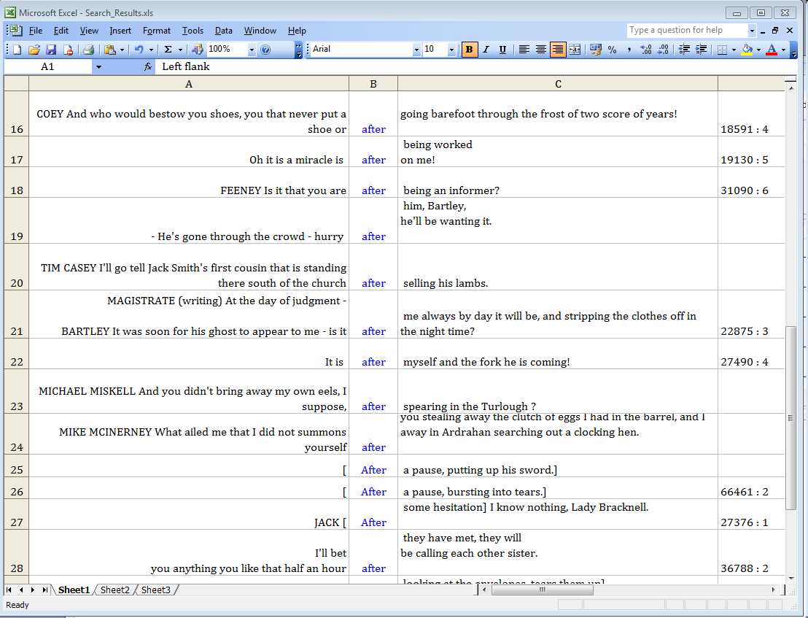
An Excel spreadsheet with a selection of finds from a search operation. The string searched for occupies the central column and is displayed in blue.

Slide 10
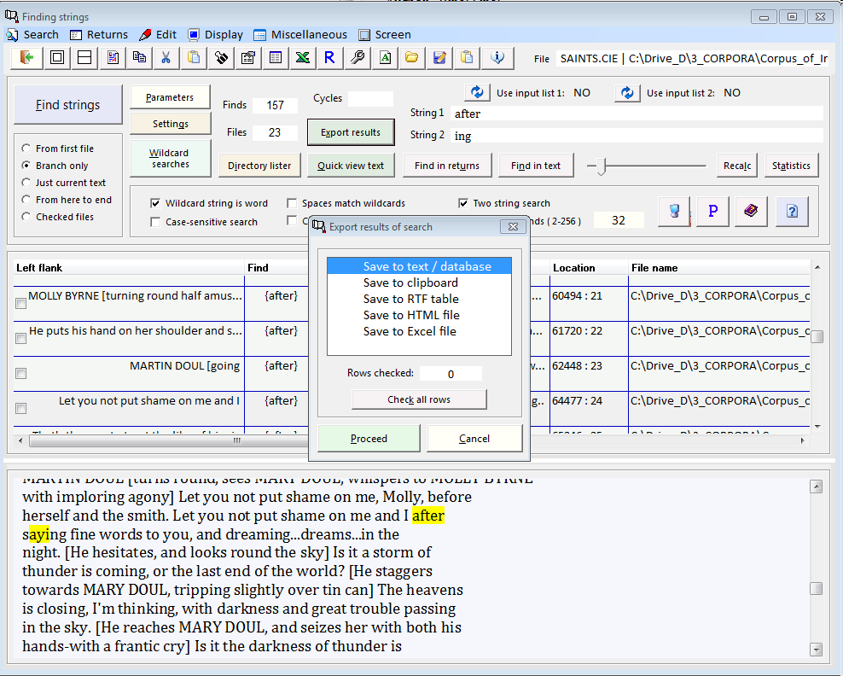
Finding strings in corpus files; here: export options

Slide 11
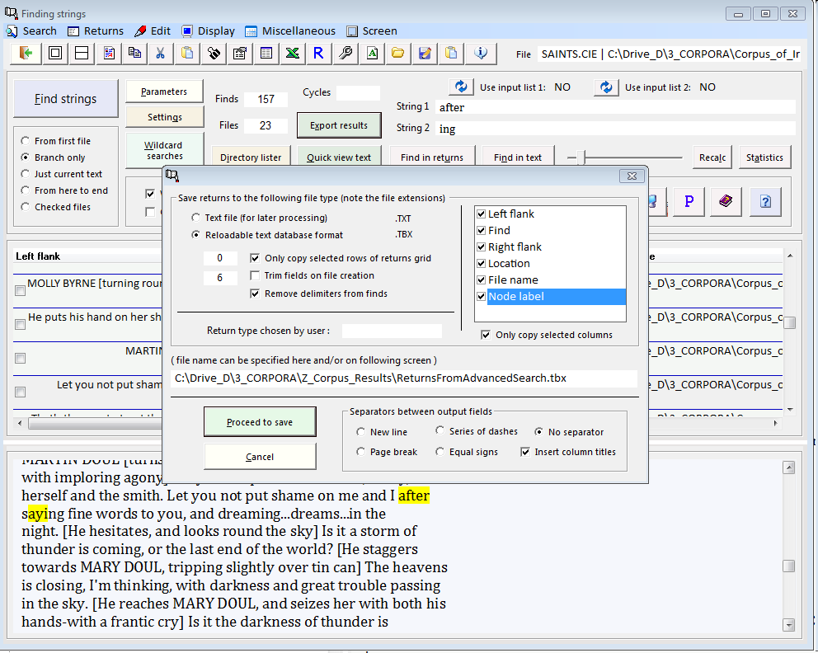
Saving files as reloadable text databases
If you save the results of an Advanced Search as a reloadable text database then you can further process this with the supplied utility CP Text Databases. You can also choose to reload a previously stored text database, goto Returns, then Load previous set of returns or just press Ctrl-F9.

Slide 12
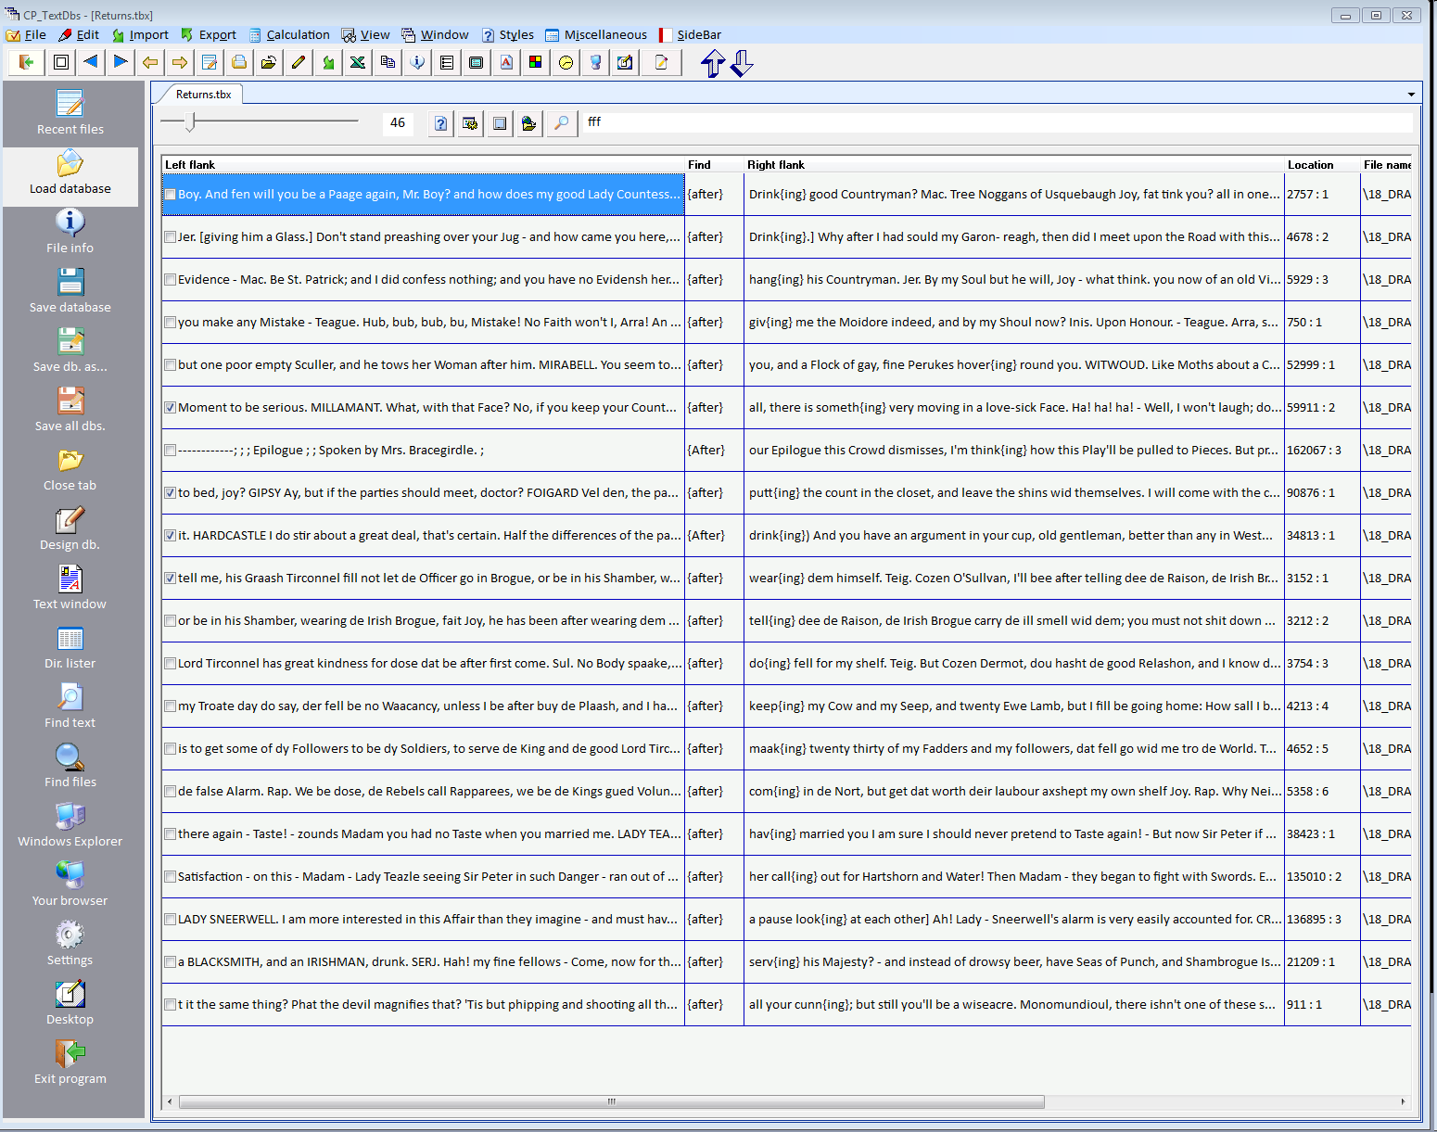
Finding strings in corpus files
A set of returns saved to disk and loaded into the supplied text database utility.
This set of returns could also be reloaded into Corpus Presenter.

Slide 13
Finding strings in corpus files; here: returns from an advanced search as an HTML table

