Slide 1


Corpus Presenter
─ Introduction ─
Raymond Hickey
www.raymondhickey.com

Slide 2
Corpus Linguistics
The goal of corpus linguistics is to extract information from corpora ̶ sets of text files ̶ with a precision and flexibility not hitherto possible by manually examining texts in printed, non-digital form.
With the great increase in computer power in the past few decades, linguists have also turned to the task of digitising large amounts of data, in a structured fashion, which can be interrogated by software for specific linguistic goals, e.g. to determine what patterns occurs in texts, how often, with what distribution and in what manner throughout history.
The present software should be understood against this background: it is intended to assist scholars and students in the task of retrieving information from sets of text files.

Slide 3
Introduction
Corpus Presenter is a program suite with which you can examine texts of a corpus, locate words and syntactic patterns and export the results of searches to various output formats to allow you to use these results for further processing.
There are a few things to bear in mind about Corpus Presenter before beginning work with it.
1) It is a program suite which only runs on the Microsoft Windows operating system. It will not work with Apple computers or on any device using the Android operating system, such as smartphones or tablets.

Slide 4
Introduction
2) For Corpus Presenter to run you must have files on your computer locally, which it can then process. These can be in a variety of formats, e.g. text files, HTML files, RTF files or Word files. When you are using files with Corpus Presenter make sure that they do not contain graphics or tables – just text, after all it is software for processing texts.
3) Corpus Presenter will display the files you load in the form of a tree, i.e. it will “present” the files to you. Once loaded you can start searching through your texts straight away, creating a concordance, generating lexical clusters, etc.

Slide 5
What can you do with Corpus Presenter ?
Corpus software, including Corpus Presenter, is designed to extract information from a corpus of text files (technically called information retrieval) and display this on screen, allowing users to view this information and save it to disk for later processing for what their particular purpose may be.
The information retrieval options in Corpus Presenter are organised into two groups of three:
1) Search options (finding strings, quick and blitz searches)
2) Listing options (word lists, concordances, lexical clustering)
The following screen shows you how to access these six options from the sidebar displayed in the opening screen of Corpus Presenter.

Slide 6
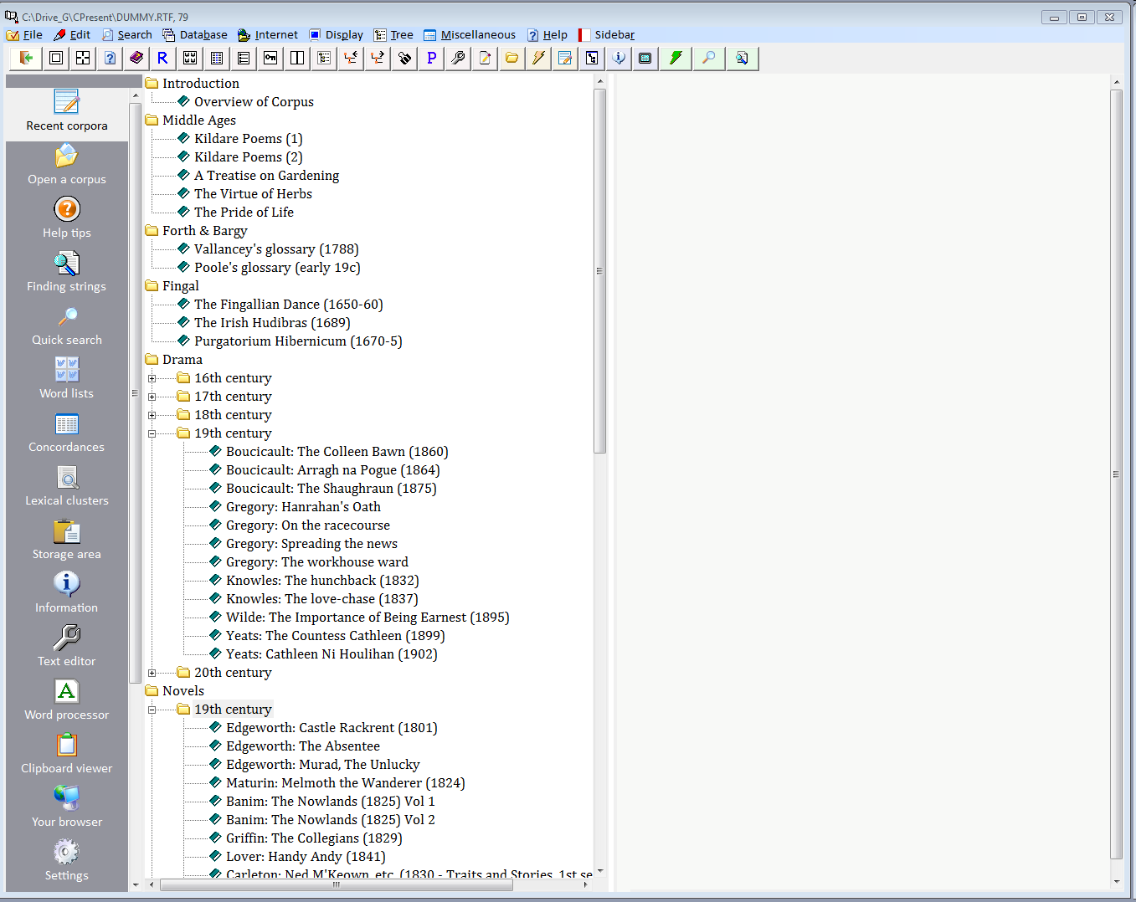
Two sets of three retrieval options in Corpus Presenter
Group 1: Search options
Group 2: Listing options

Slide 7
Tutorials for Corpus Presenter
There are seven tutorials available for Corpus Presenter, which should be consulted when you are finished with this introduction. The first five are dedicated to the retrieval tasks possible with the program:
Tutorial 1: Finding strings
Tutorial 2: Quick and blitz searches
Tutorial 3: Generating word lists
Tutorial 4: Making concordances
Tutorial 5: Examining lexical clusters
In addition there are two further tutorials:
Tutorial 6: Pre- and postprocessing of texts
Tutorial 7: Additional utilities

Slide 8

Starting to work with Corpus Presenter
The following slides explain how you can begin working with Corpus Presenter. They explain what you need to start with, how a corpus is “presented”, i.e. displayed within the program. Here you can recognise the advantages of arranging the text files of a corpus in the form of a tree with branches.
The other tutorials with then take you through the search and listing options which the program puts at your disposal.

Slide 9
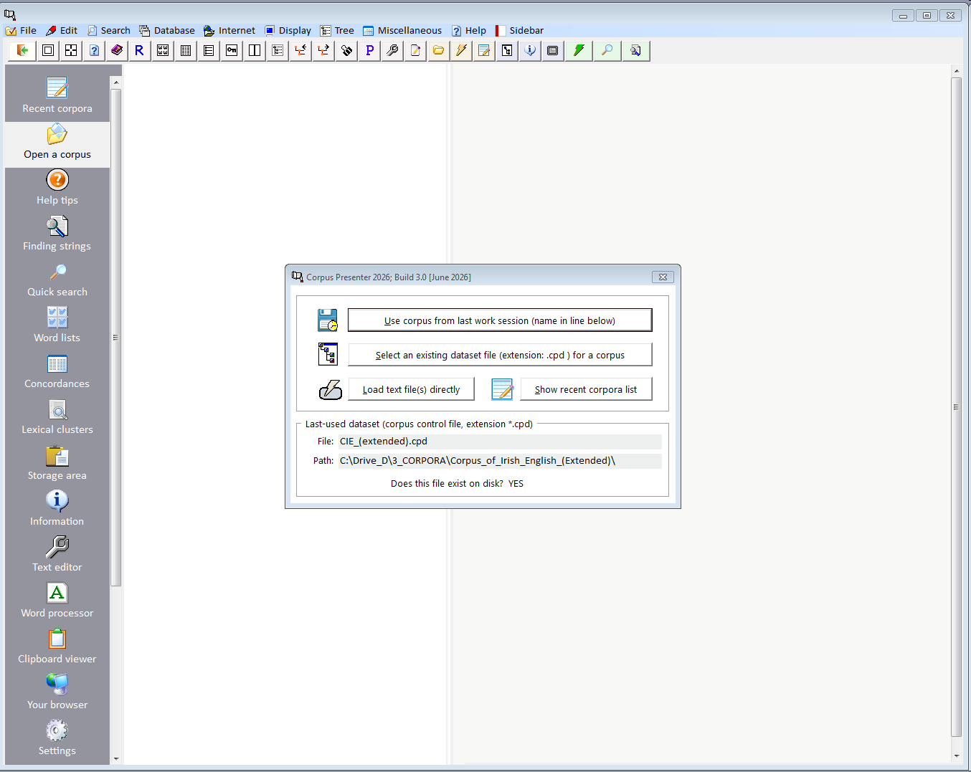
Assuming you have downloaded Corpus Presenter from the website and installed it on your computer, you can then start it (by clicking the Corpus Presenter link on your desktop). When you do, the screen which you see is the following:
You can now choose one of four options:
1) Use the corpus you were working with during the previous session (assuming that you had one).
2) Load a previous corpus by selecting its associated CPD file.
3) Load any files you like directly into Corpus Presenter.
4) Select a corpus from a list of recently used corpora (this list is maintained internally by the program).

Slide 10
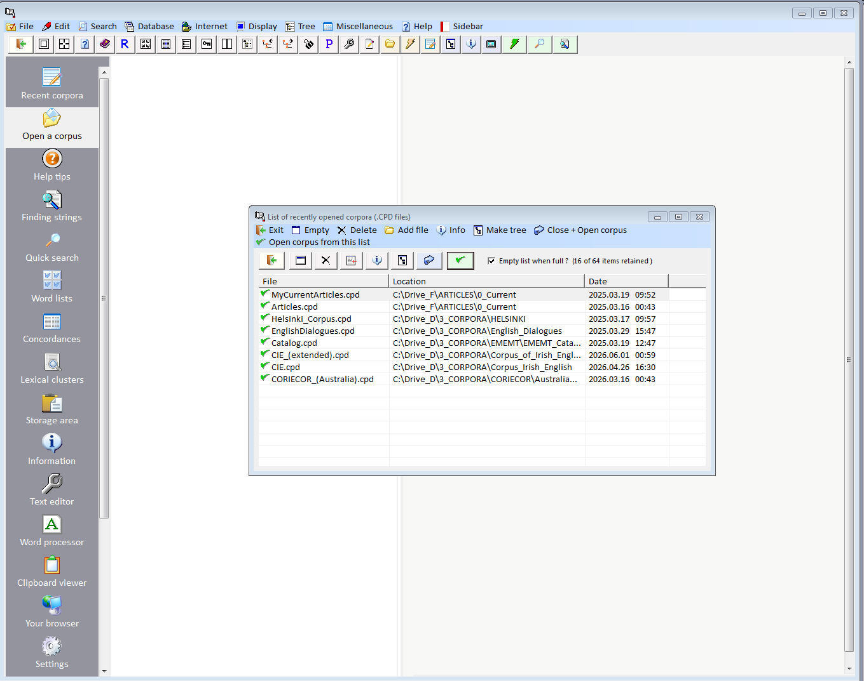
This screen shot shows a window with a list of corpus presenter dataset files (all with the extension .CPD). By doubling clicking on one you can load the associated corpus.

Slide 11
What is a CPD file?
Every corpus you process with Corpus Presenter will have one file with the extension .CPD which stands for “Corpus Presenter Dataset”. This small file holds all the information about a specific corpus, i.e. which files it contains, how these are arranged in terms of branches of a tree which is displayed by Corpus Presenter.
N.B.: There is a utility called Make Tree (CP_MakeTree.exe) with which you can create a tree for Corpus Presenter or edit an existing CPD file.
You can, of course, start working with Corpus Presenter by simply loading the CPD file (CIE_(extended).cpd) which is found in A Corpus of Irish English, which can be downloaded from the same webpage as Corpus Presenter.

Slide 12
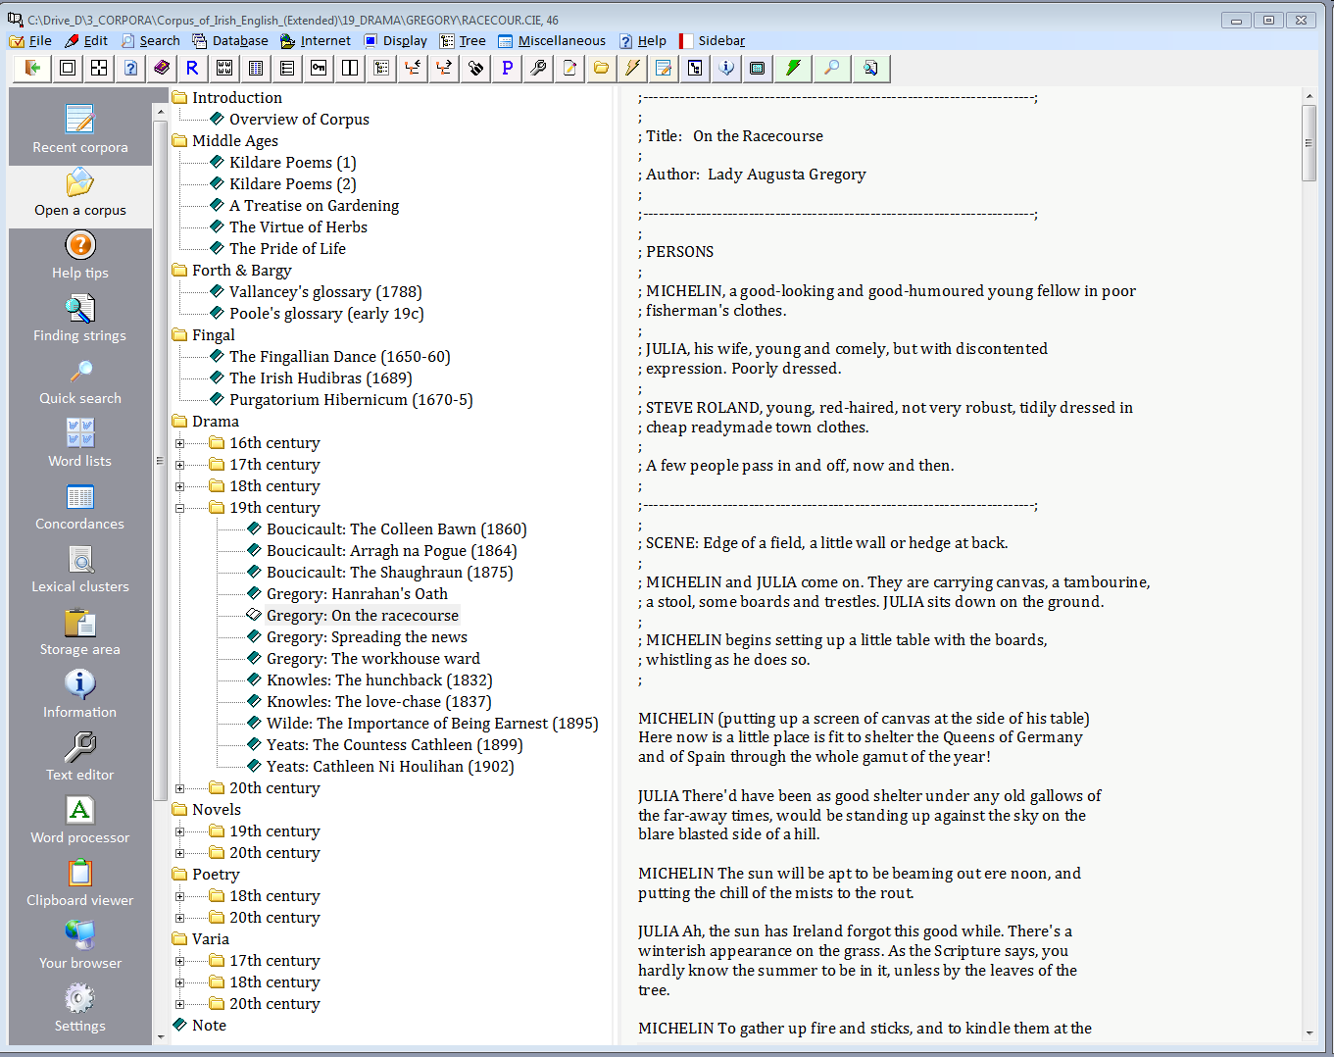
The tree view of A Corpus of Irish English when loaded with Corpus Presenter

Slide 13
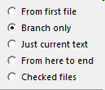
Corpus Presenter can do searches on parts of a corpus, i.e. by restricting a search to a part of the corpus tree. Every search option allows you to specify the range of a search.
Branch of corpus tree. This can be used to narrow down a search. The following options are present for all types of operation:

Slide 14
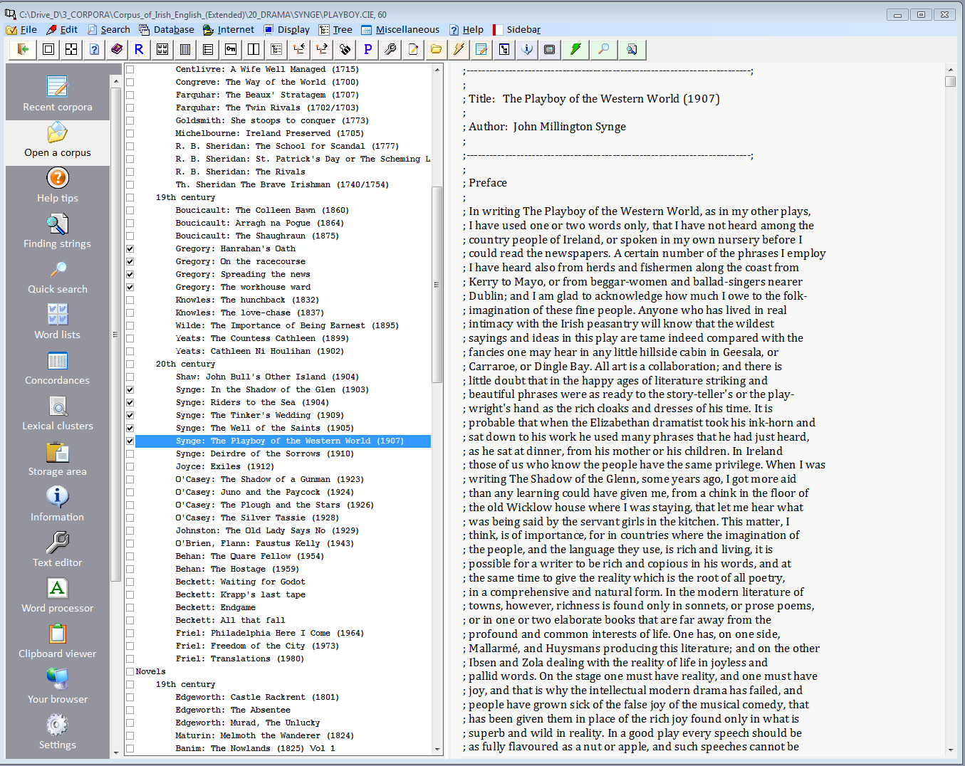
Corpus Presenter can display files in a list mode. This allows you to select files for a search which are not necessarily in a branch of the corpus (see tick boxes on the left of the list in the following two screen shots).

Slide 15
File display as list (allowing selection of any files, irrespective of their position in a corpus tree)

Slide 16
Remember: there is HELP available all the time!
1) From the desktop of the program (the opening screen), there is a button “Help tips” in the left-hand side-bar, see next slide.
2) By pressing F1 or clicking on the help symbol you can access immediate help. The symbol may be a book with a question mark on it [full help text] or just a question mark on the blue background [context-sensitive help].

Slide 17
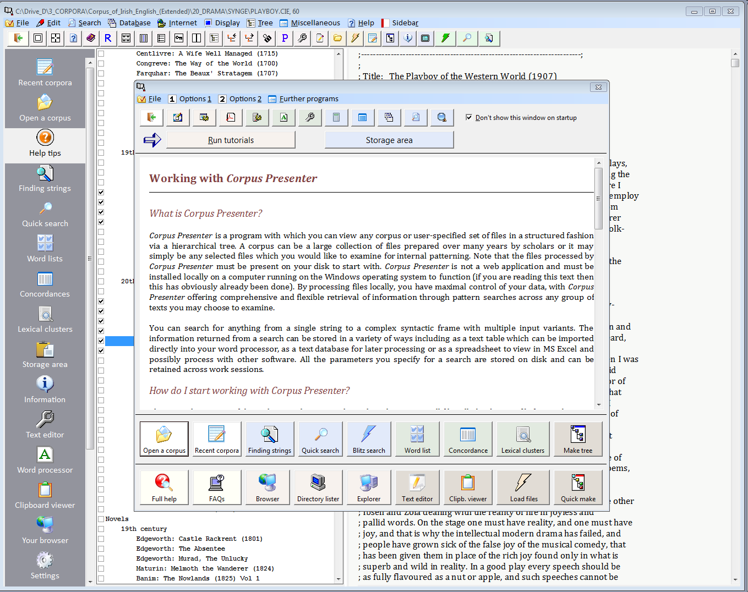
Remember: Help is always available by clicking on this symbol in the side bar or just pressing F1 (see next slide for a screenshot)

Slide 18
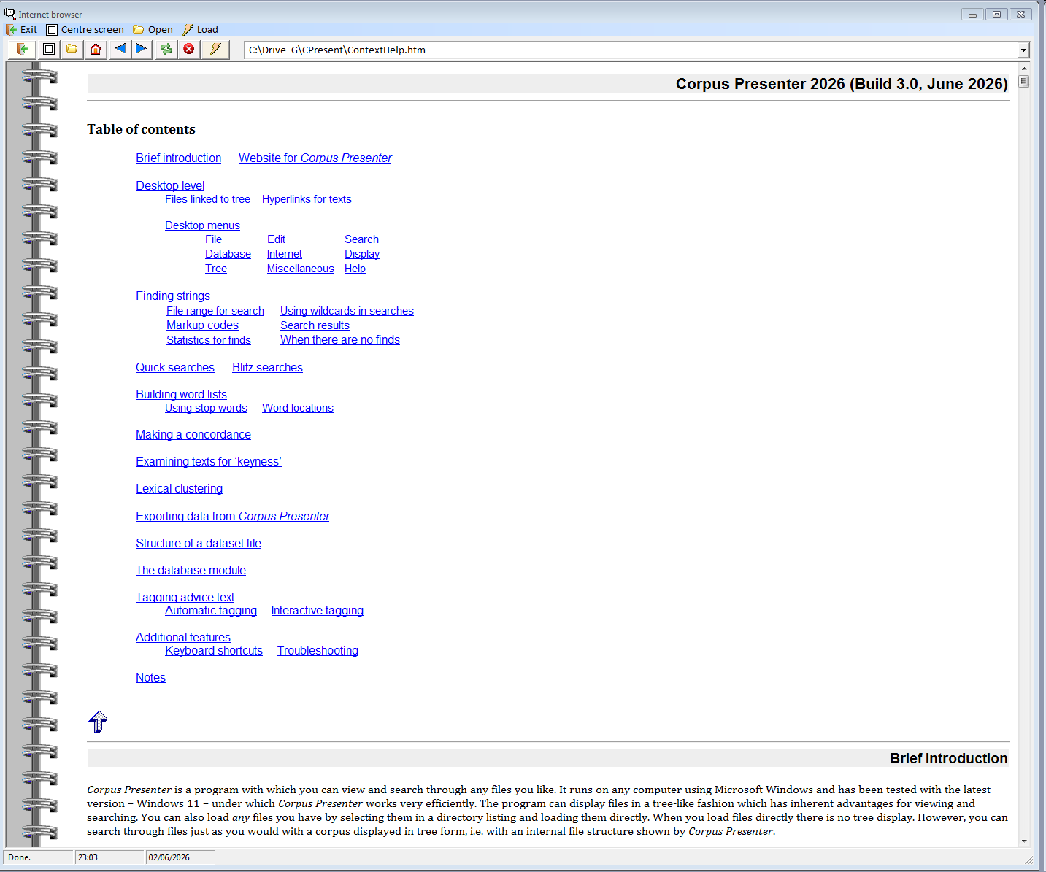
Help is always available in Corpus Presenter by pressing F1. The help is furthermore specific to the task you are currently performing, e.g. searching for words or phrases.

